Slide 1
Chapter 6 Security Protocols
Chapter 6.1
PKI

Slide 2
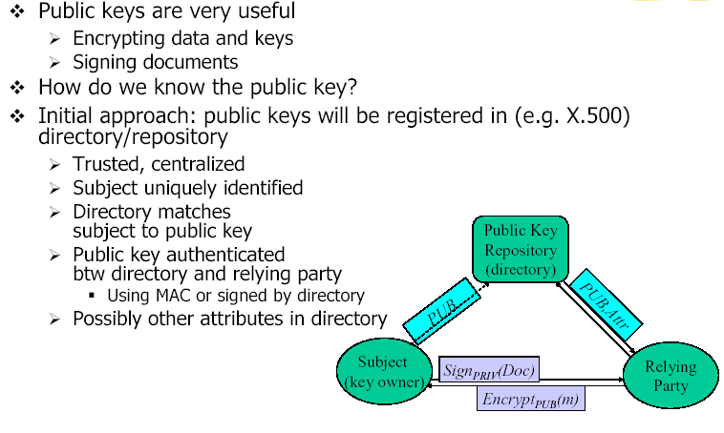
Relying on Public Keys

Slide 3
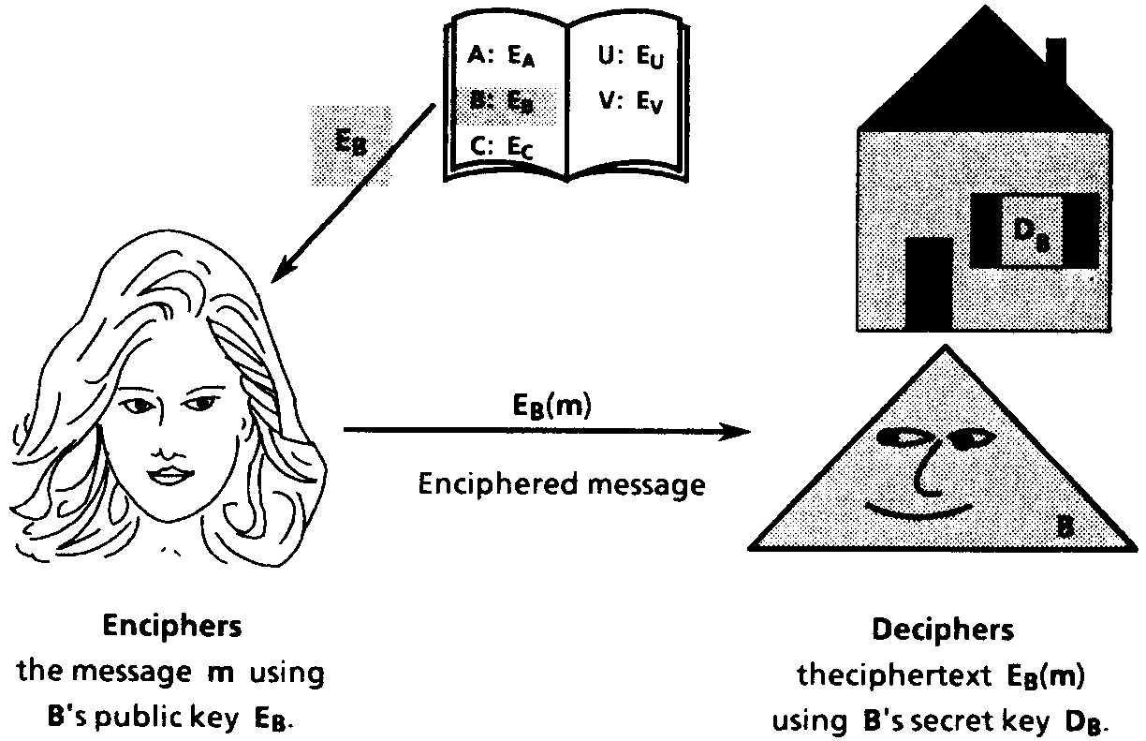
Public Key Encryption Scheme

Slide 4
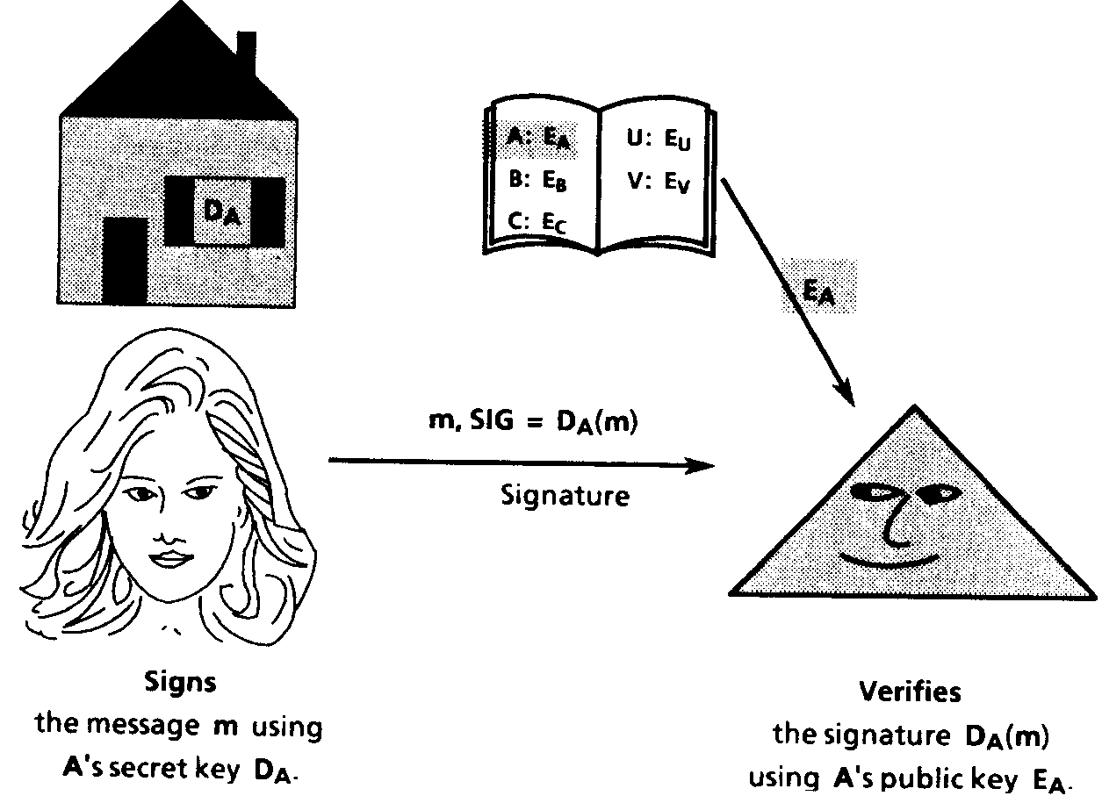
Digital Signature Scheme

Slide 5
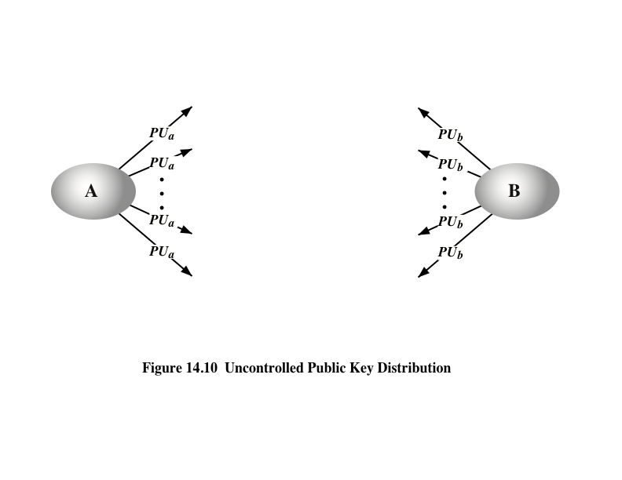
Public Key Distribution
Notes:
On the face of it, the point of public-key encryption is that the public key is public.
Thus, if there is some broadly accepted public-key algorithm, such as RSA, any participant
can send his or her public key to any other participant or broadcast the key to the
community at large (Figure 14.10). For example, because of the growing popularity of
PGP (pretty good privacy, discussed in Chapter 19), which makes use of RSA, many
PGP users have adopted the practice of appending their public key to messages that
they send to public forums, such as USENET newsgroups and Internet mailing lists.
Although this approach is convenient, it has a major weakness. Anyone can
forge such a public announcement. That is, some user could pretend to be user A
and send a public key to another participant or broadcast such a public key. Until
such time as user A discovers the forgery and alerts other participants, the forger is
able to read all encrypted messages intended for A and can use the forged keys for
authentication (see Figure 9.3).

Slide 6
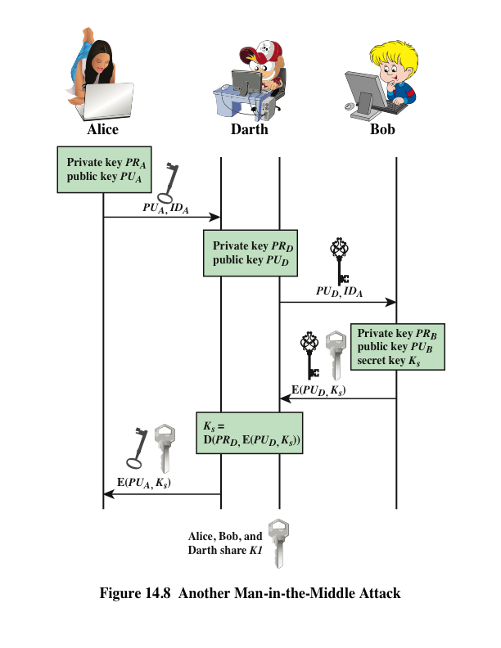
Notes:
The protocol depicted in Figure 14.7 is insecure against an adversary who
can intercept messages and then either relay the intercepted message or substitute
another message (see Figure 1.3c). Such an attack is known as a man-in-the-middle
attack [RIVE84]. We saw this type of attack in Chapter 10 (Figure 10.2). In the
present case, if an adversary, D, has control of the intervening communication channel,
then D can compromise the communication in the following fashion without
being detected (Figure 14.8).
Thus, this simple protocol is only useful in an environment where the only threat is eavesdropping.

Slide 7
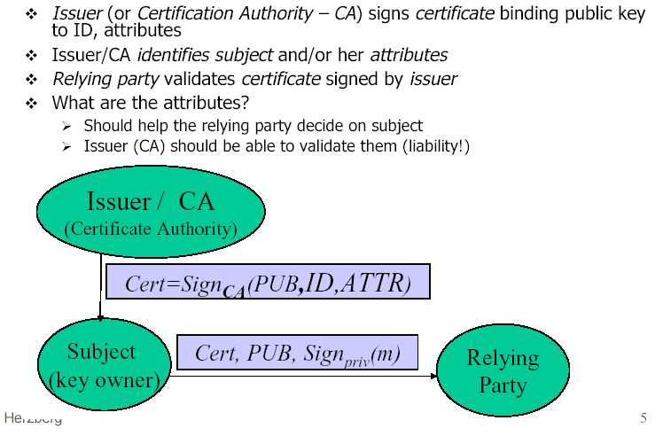
Public Key Certificate

Slide 8
Public Key Infrastructure (PKI)
PKI is a framework that binds public keys with respective user identities by means of a certificate authority (CA). The purpose of a PKI is to facilitate the secure electronic transfer of information for a range of network activities such as e-commerce, internet banking and confidential email.

Slide 9
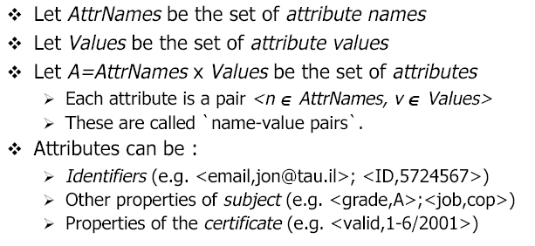
Certificate Attributes

Slide 10
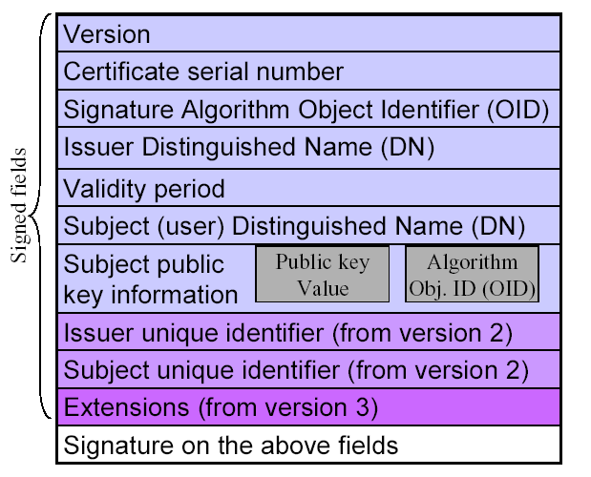
X. 509 Public Key Certificate

Slide 11
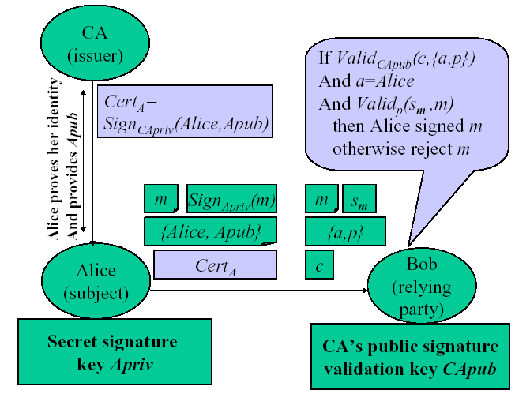
Certification Authority (CA)

Slide 12
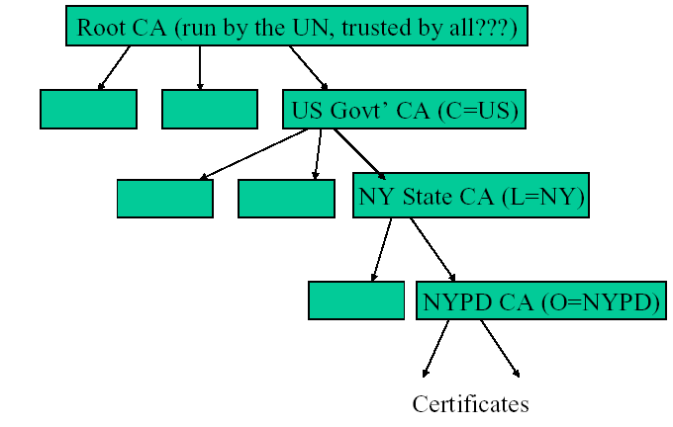
Global X. 509 CA Hierarchy

Slide 13
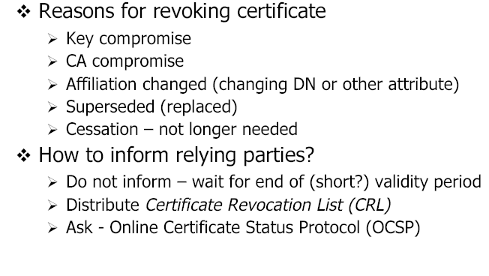
Certificate Revocation

Slide 14
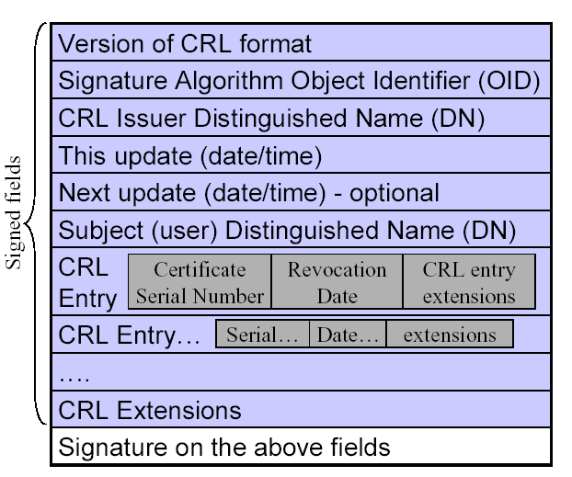
X. 509 CRL Format

Slide 15
Chapter 6 Security Protocols
Chapter 6.2
SSL

Slide 16



Cloud Computing

Slide 17
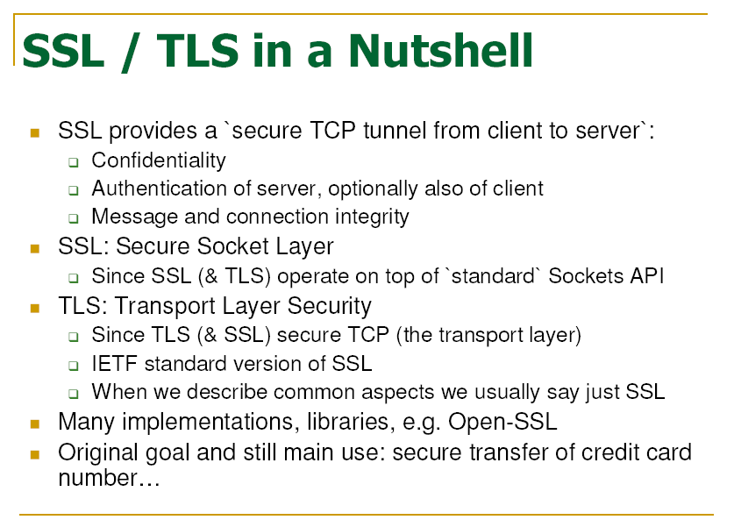
Notes:
TCP port number is 443.
The default port to enable for SSL is Port 443.

Slide 18
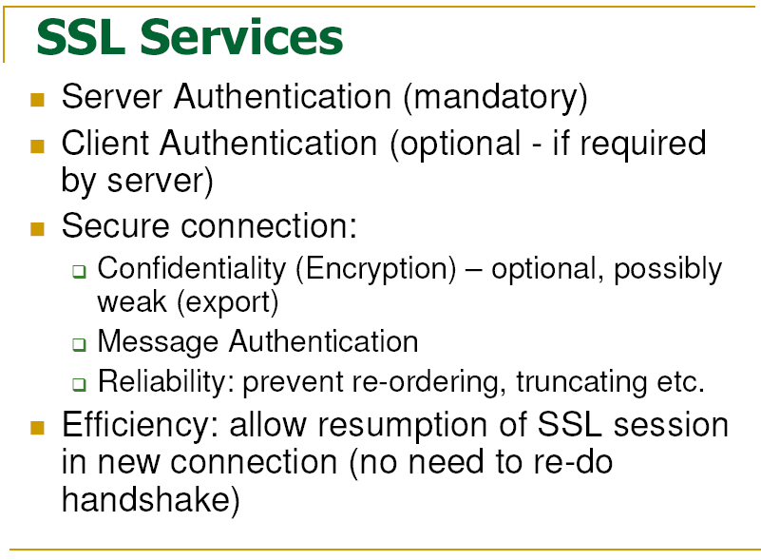

Slide 19
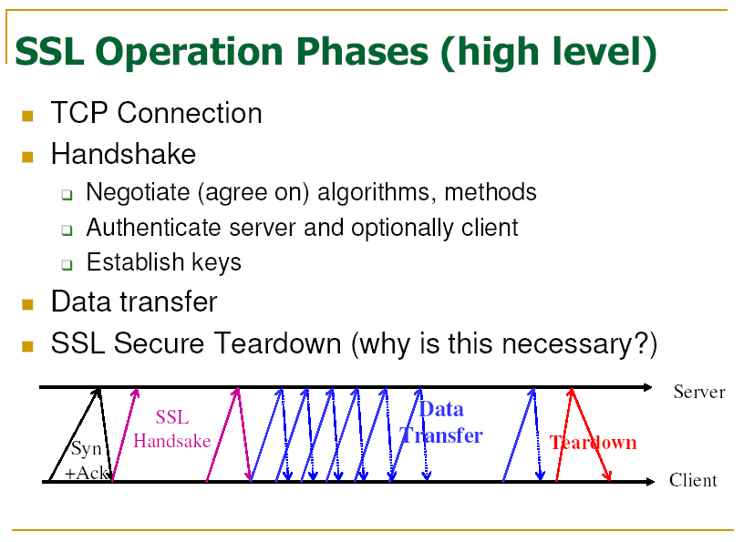

Slide 20
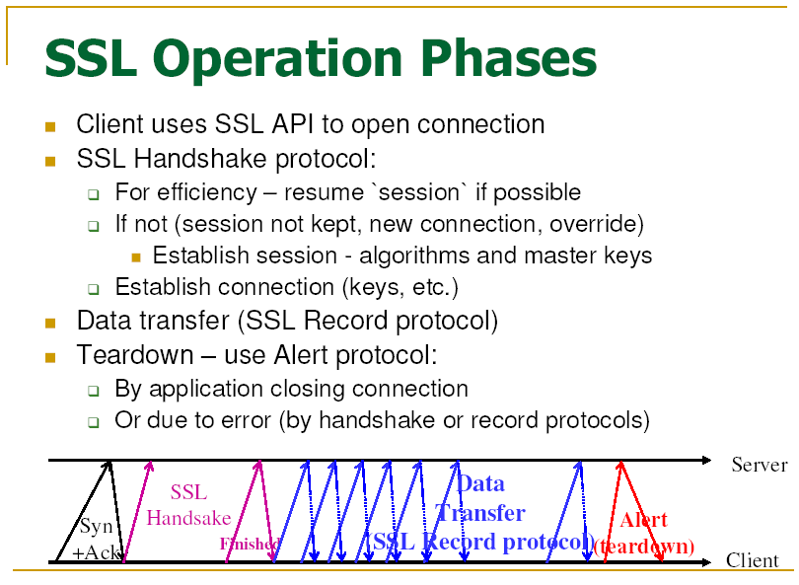
Notes:
The 443 is the default TCP port used for HTTPS.

Slide 21
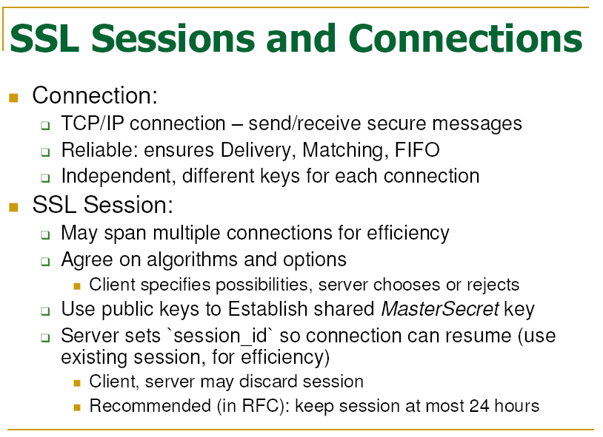
Notes:
SSL runs in sessions. Each session comprises multiple connections.

Slide 22
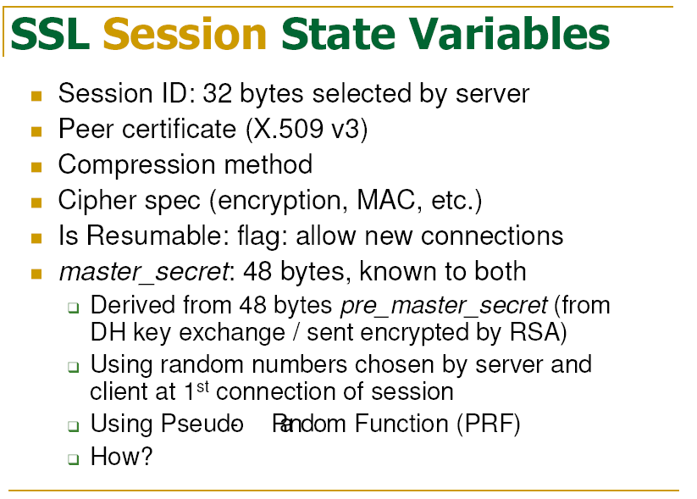

Slide 23
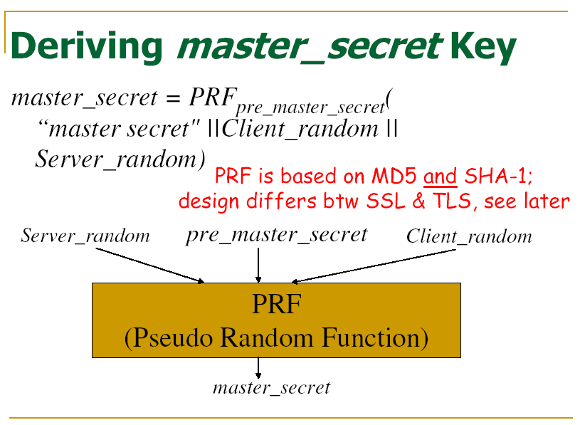

Slide 24
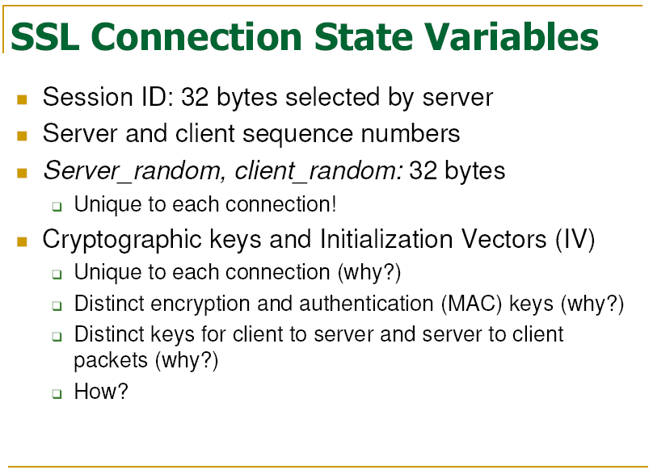
Notes:
Replaying attack

Slide 25
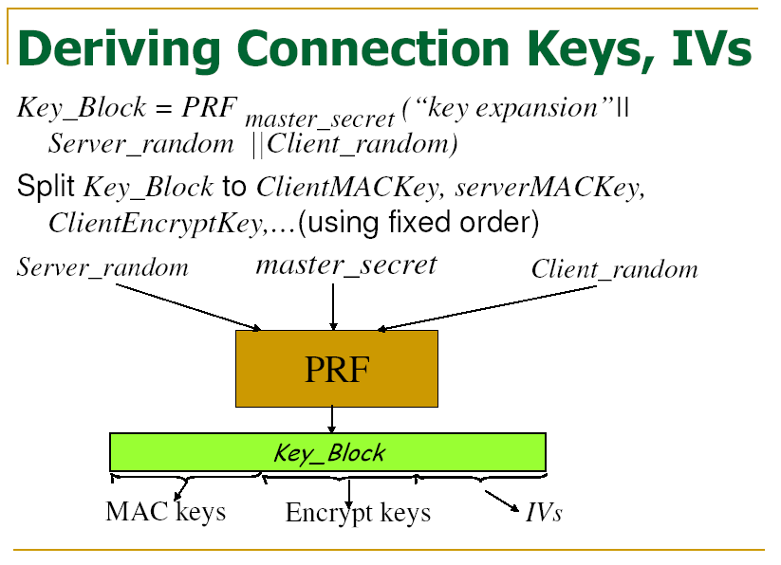

Slide 26
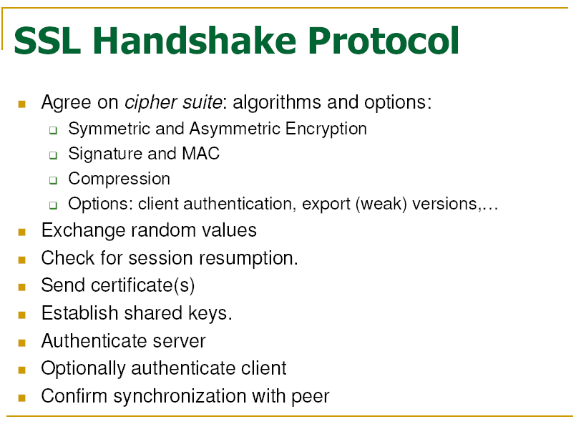

Slide 27
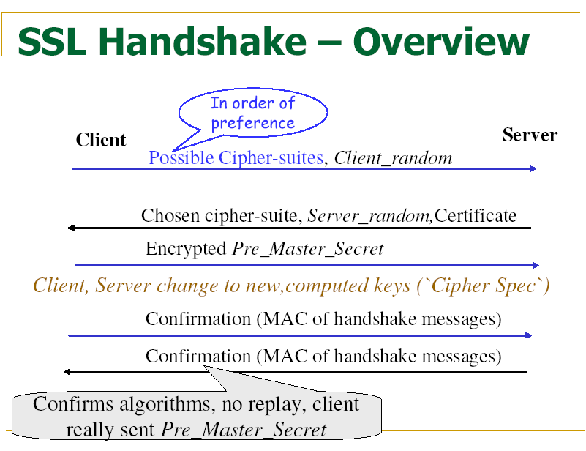

Slide 28
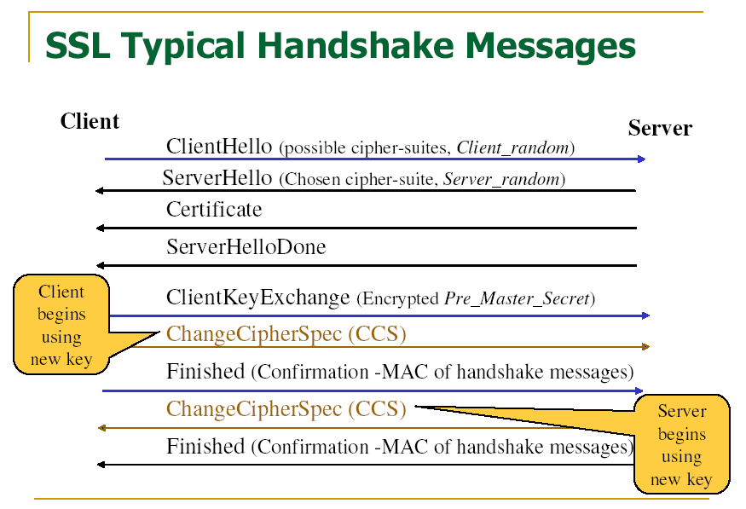

Slide 29
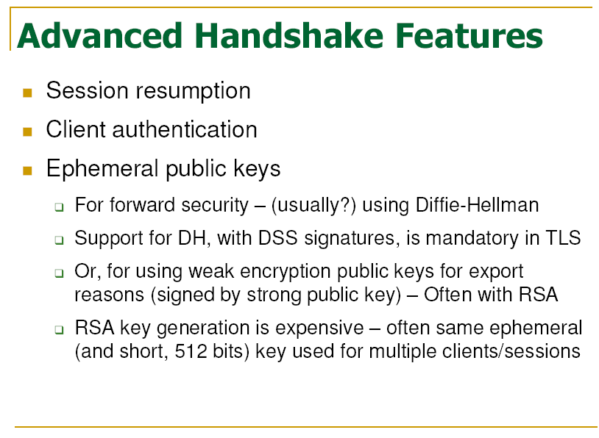

Slide 30
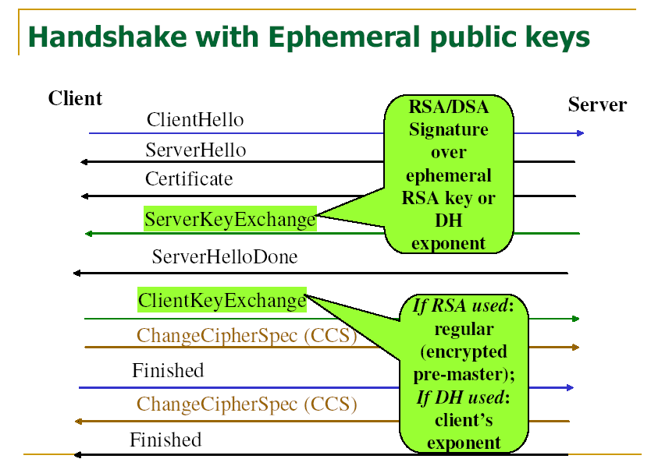

Slide 31
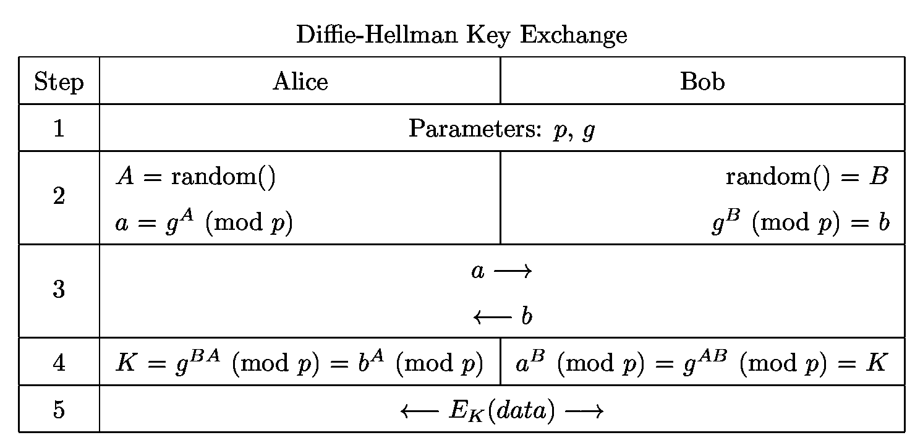
Diffie-Hellman Key Exchange

Slide 32
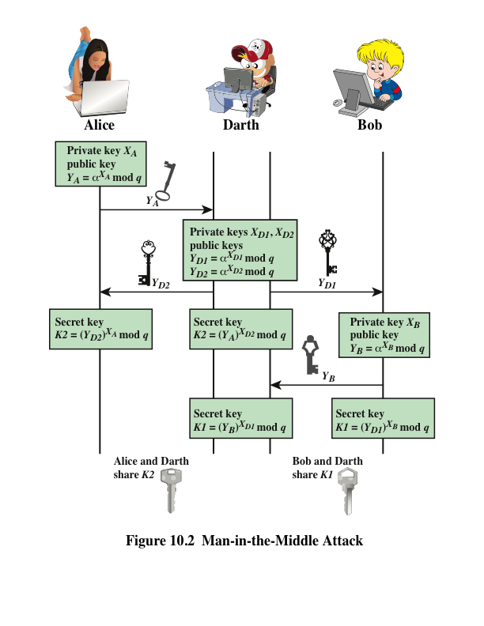
Notes:
The protocol depicted in Figure 10.1 is insecure against a man-in-the-middle attack.
Suppose Alice and Bob wish to exchange keys, and Darth is the adversary. The
attack proceeds as follows (Figure 10.2).
Darth prepares for the attack by generating two random private keys X_{D1} and X_{D2} and then computing the corresponding public keys Y_{D1} and Y_{D2}
Alice transmits Y_{A} to Bob.
Darth intercepts Y_{A} and transmits Y_{D1} to Bob. Darth also calculates K2 = (Y_{A} )^ X_{D2} mod q
Bob receives Y_{D1} and calculates K1=(Y_{D1} )^ X_{B} mod q
Bob transmits Y_{B} to Alice.
Darth intercepts Y_{B} and transmits Y_{D2} to Alice. Darth calculates K1=(Y_{B} )^ X_{D1} mod q
Alice receives Y_{D2} and calculates K2=(Y_{D2} )^ X_{A} mod q .
At this point, Bob and Alice think that they share a secret key, but instead Bob and Darth share secret key K1 and Alice and Darth share secret key K2. All future communication between Bob and Alice is compromised in the following way:
Alice sends an encrypted message M: E(K2, M).
Darth intercepts the encrypted message and decrypts it, to recover M.
Darth sends Bob E(K1, M) or E(K1, M'), where M' is any message. In the first case, Darth simply wants to eavesdrop on the communication without altering it. In the second case, Darth wants to modify the message going to Bob.
The key exchange protocol is vulnerable to such an attack because it does not authenticate the participants. This vulnerability can be overcome with the use of digital signatures and public- key certificates.

Slide 33
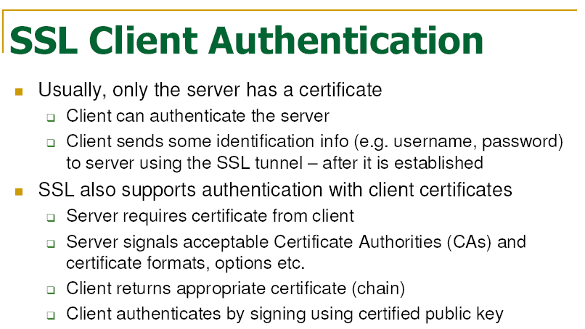

Slide 34
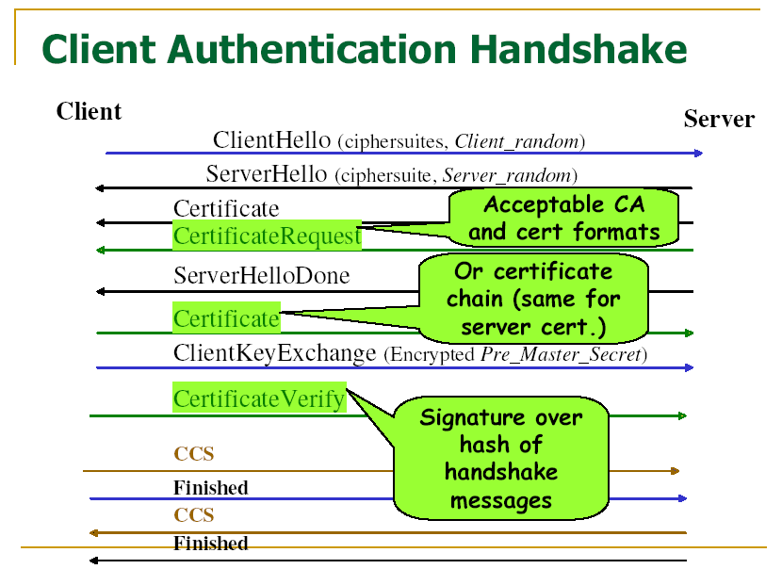

Slide 35
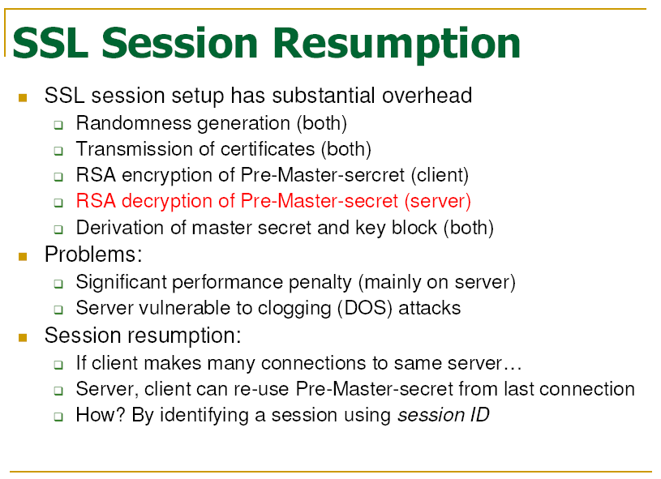

Slide 36
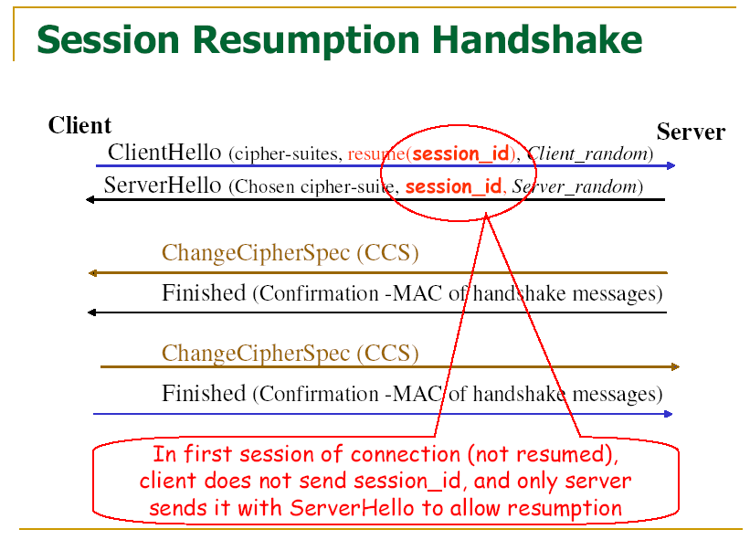

Slide 37
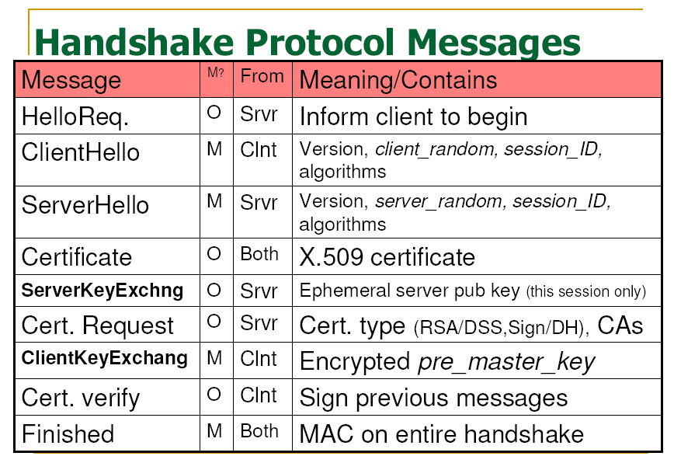

Slide 38
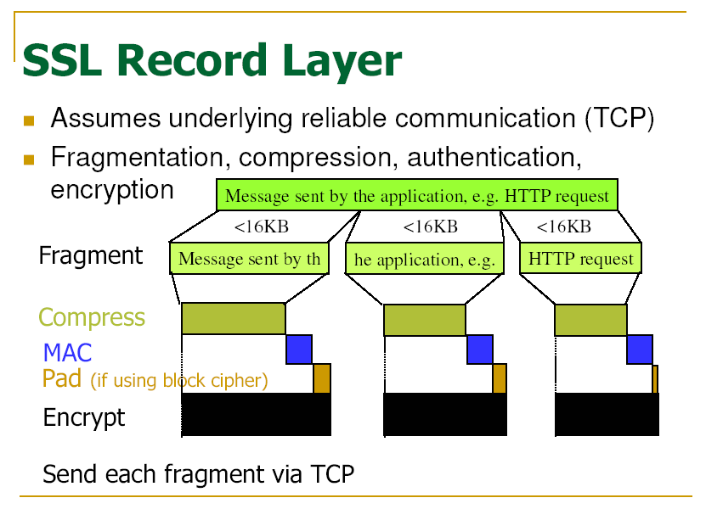

Slide 39
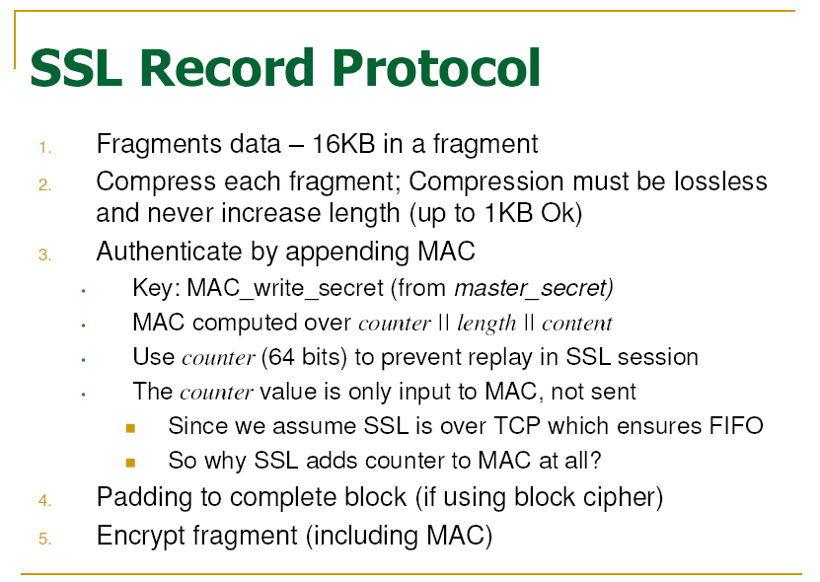
Notes:
First-In-First-Out (FIFO)

Slide 40
